Slide 1
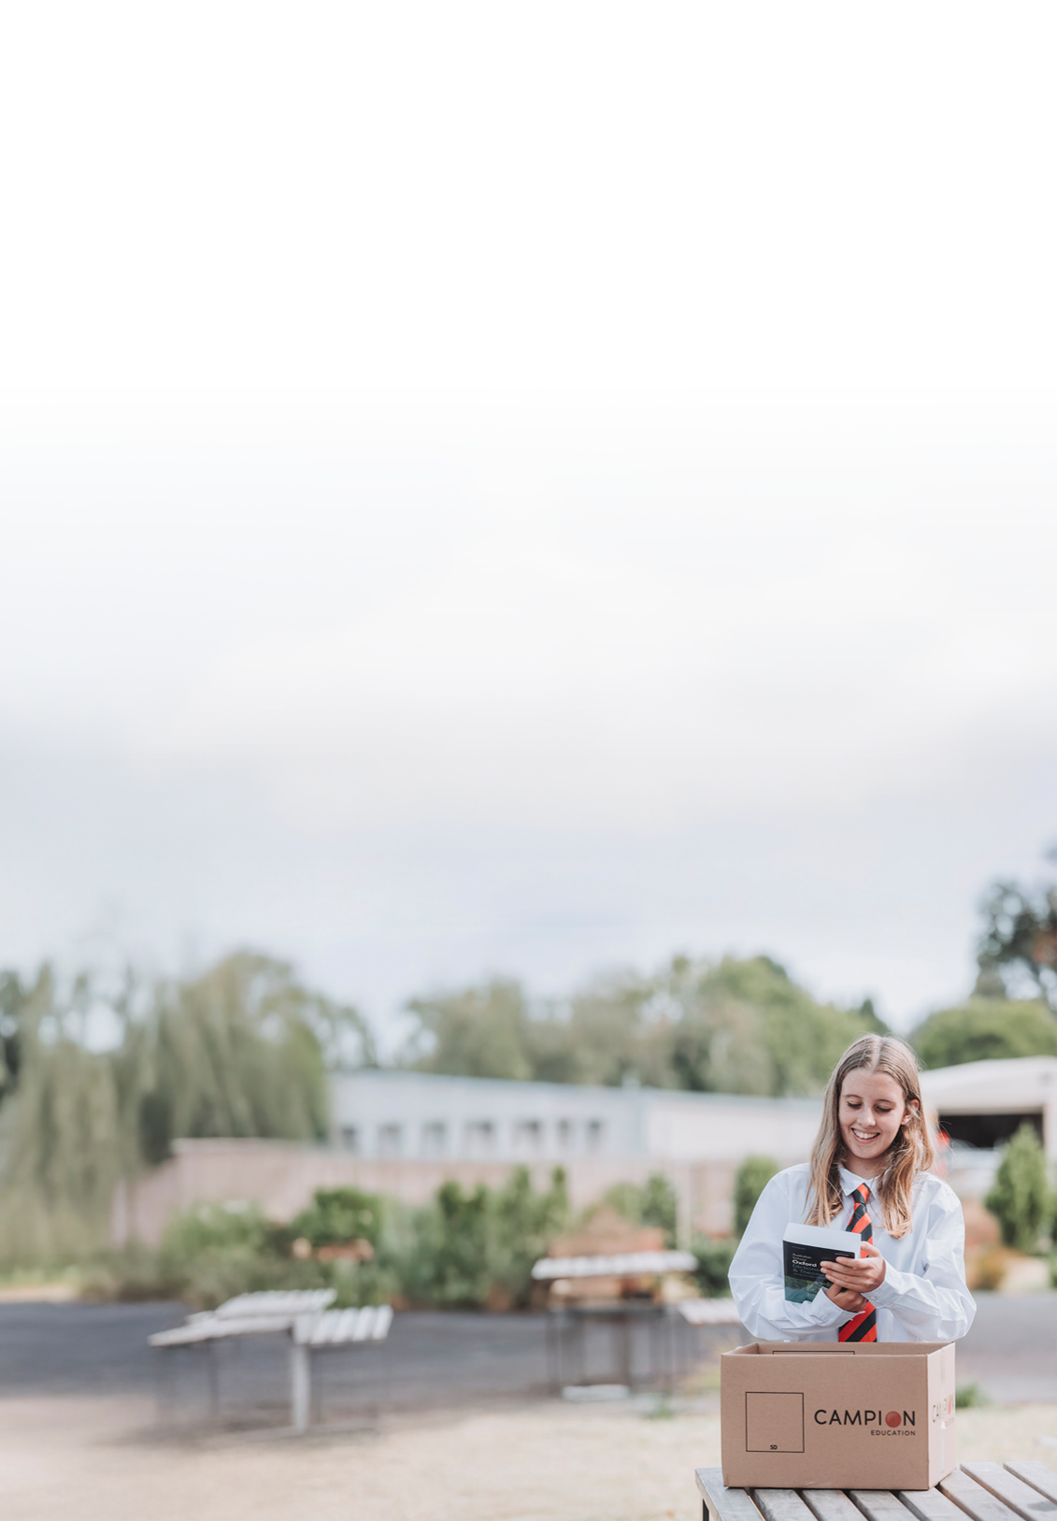

2027 GUIDE
Parents & Students
St Kevin's College - Junior School

Slide 2


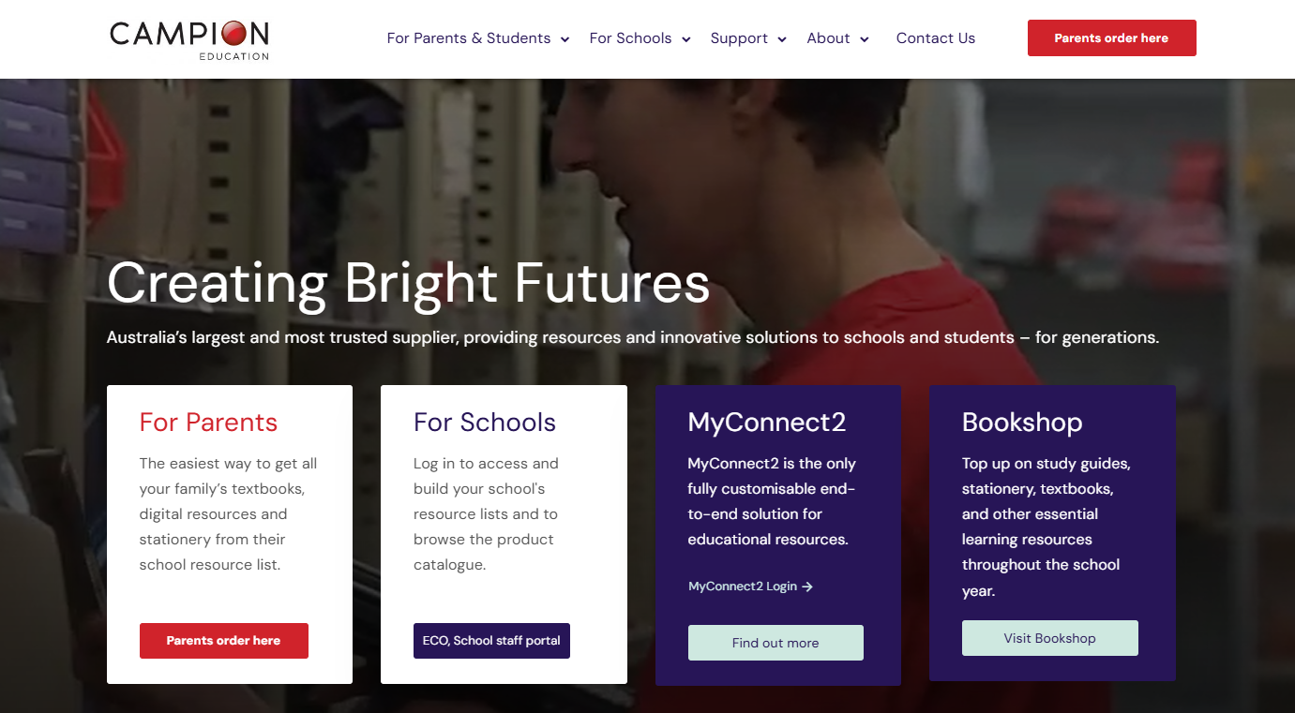
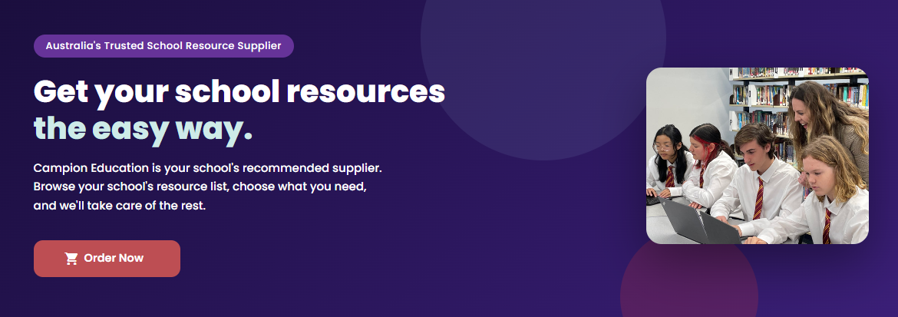
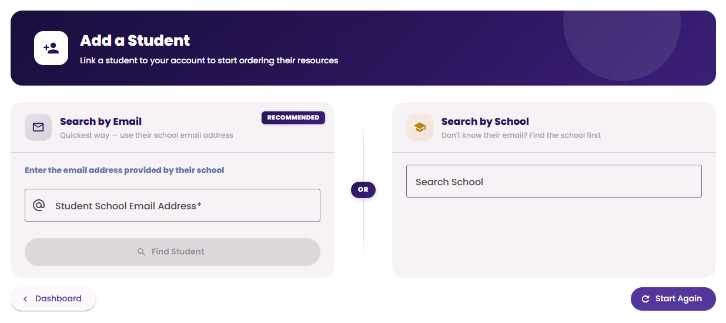
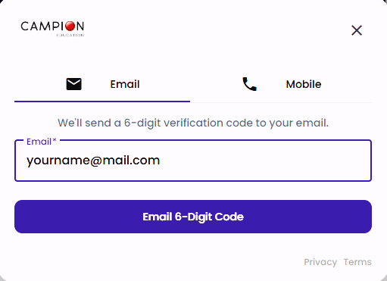
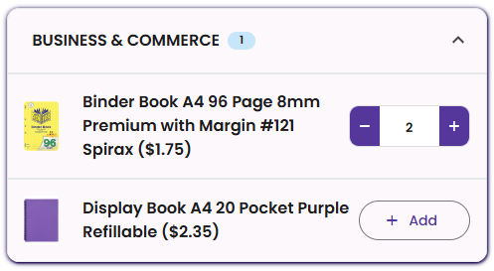
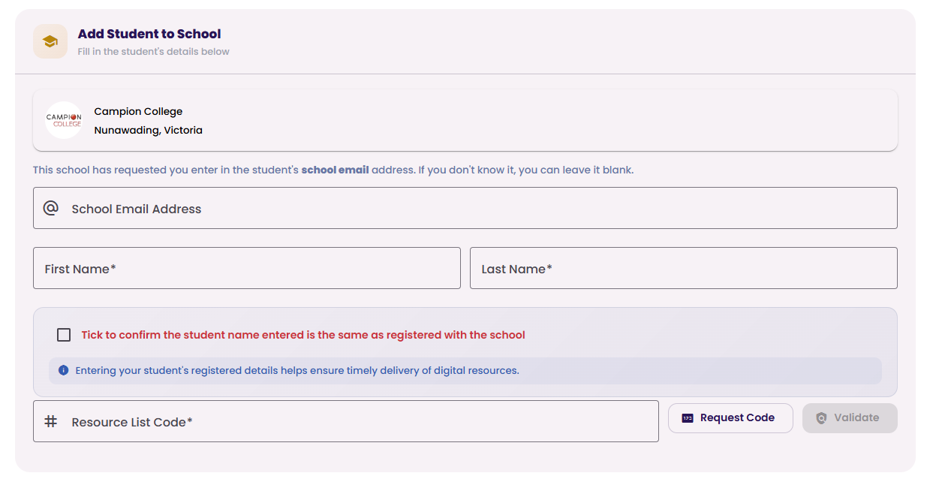
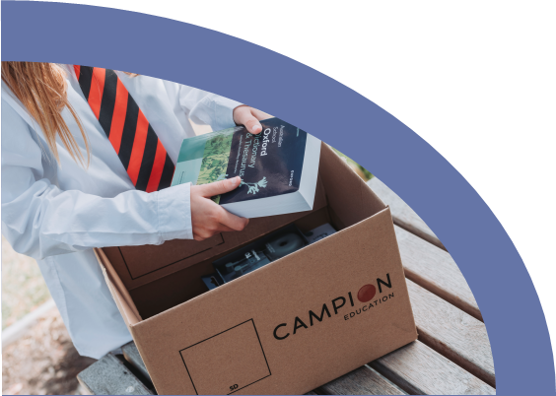



ORDERING ONLINE
How To Order Online
St Kevin's College - Junior School
Your school has partnered with Campion for learning resources. The Campion list will show you the exact items your child requires for their year at school.
STEP 1
STEP 2
STEP 3
Go to campion.com.au
Click ‘Parents order here’
Click Order Now
Type your email or mobile to get a code to login
Add your child’s school email or search for their school if you don’t have their email
If your child is already registered with Campion, this step will be skipped – go to step 5.
STEP 4
STEP 5
STEP 6
Add your child’s details. If you don’t know their school email address, don’t worry – you can leave that blank.
Add the unique Resource List Code TD7Pto bring up their list
Select the resources from the drop-down lists and click through to finalise your cart.
Select your delivery method and complete transaction.
Delivery Before Cutoff:
Order by 07-Dec-2026 for delivery to your nominated home address
Delivery After Cutoff:
Orders made after cutoff will have an increased delivery cost and can't be guaranteed to arrive prior to school starting
Don’t forget to order by 07-Dec-2026
using your unique code TD7P
Notes:
Select school or email address.

Slide 3
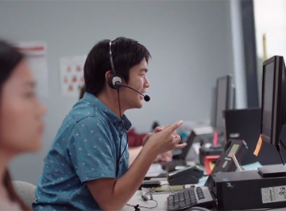
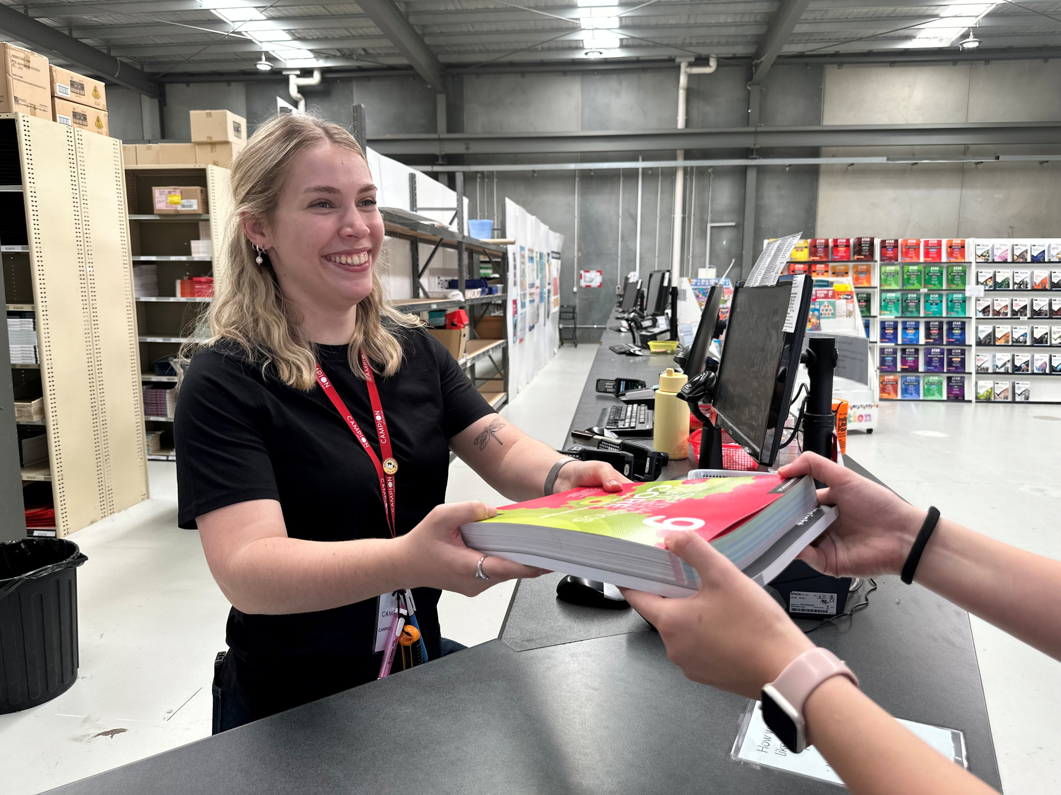
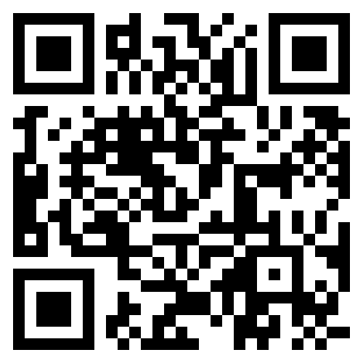
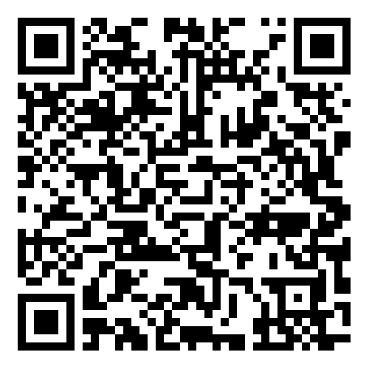
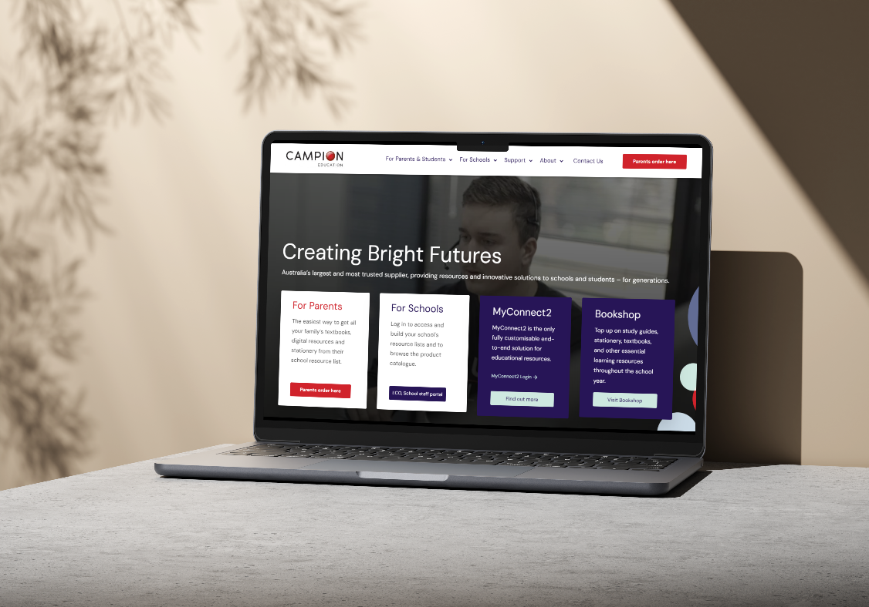

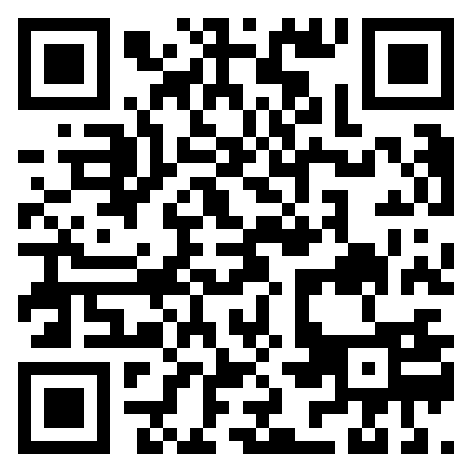
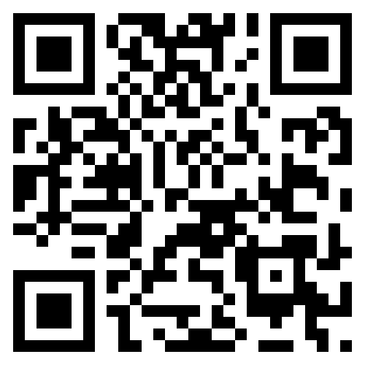
SUPPORT
Support for Parents
Customer Care
Contact our Australian-based call centre via phone or email
Retail Locations
Visit any of retail locations for in-person ordering, service and support
1300 433 982
help@campion.com.au
campion.com.au/locations
Or scan the QR code above
FAQs & Information
Information on key questions on all Campion related services
Video Guides
Step-by-step guides on ordering, using codes, MyConnect2 and more
campion.com.au/support
Or scan the QR code above
campion.com.au/guides
Or scan the QR code above

Slide 4
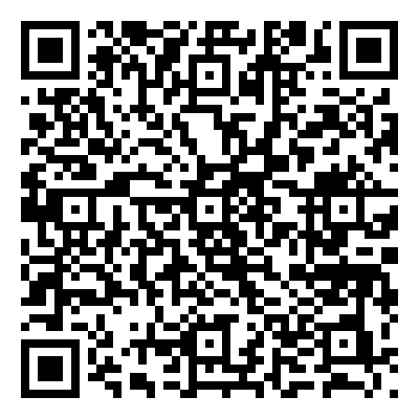
FAQs
Frequently Asked Questions
When will my order be delivered?
Delivery before cutoff: if you ordered prior to your school’s order-by date, delivery for available items is scheduled for late January before school starts, or earlier.
Standard delivery: If you ordered delivery after the cutoff, we will get your parcel including all available items handed over to Australia Post as soon as we can, generally within 3-5 business days.
Can I combine delivery costs for multiple children?
At Campion, each child’s order is packed separately by year level to keep items accurate, avoid mix‑ups, and deliver faster – and it means you don’t have to sort out which books belong to which child at home. Because orders are processed individually, we are unfortunately not able to combine delivery costs. To keep delivery as affordable as possible, we recommend ordering by your school’s order‑by date.
Can I go in store to order and pick up my child’s resources?
Absolutely – if you prefer, you can visit a local Campion store to pick up resources for your children. We also have Click & Collect options available for some stores at certain times of the season; if available you will see this option via the Checkout page on the online ordering site.
How can I set up my child’s digital resources?
If you have selected digital resources in your Campion order, we will send a follow up email outlining the steps to activate and access that digital resource; the process will vary based on whether your child’s school uses MyConnect2 or not. For more information, please go to: Ordering & Accessing Digital Products on the Campion website or scan the adjacent QR code.
Notes:
Don’t know their email address. Select school.

